Slide 1
Agenda
Introduction
Literature survey
Challenges
Dataset description
Methodology
Data analysis
ML model
DL model
Explainable AI
Conclusion
Future Enhancement

Slide 2
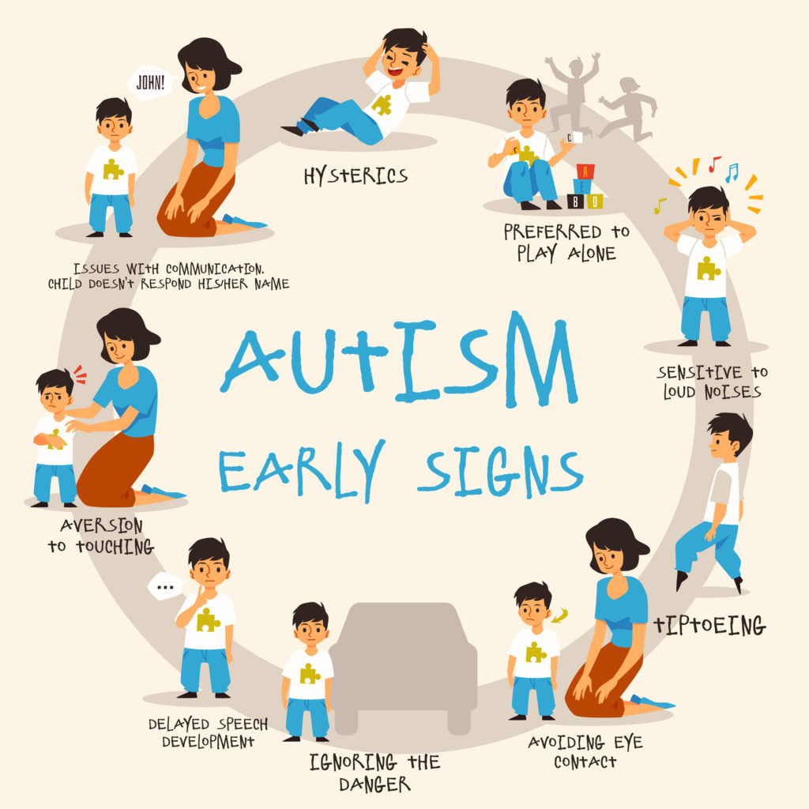
Introduction
Autism Spectrum Disorder (ASD) represents a heterogeneous set of neurobiological disorders characterized by defects in social communication and reciprocal interactions, repetitive, as well as stereotypic behaviors.
When the children are performing their regular day-today activities, some of the self-stimulatory behaviors, such as arm flapping, head banging, or spinning behaviors can be studied by automatically analysing the captured videos.

Slide 3
Problem Statement
Develop an automated system for detecting and analyzing self-stimulatory behaviors in children with Autism Spectrum Disorder (ASD) through the analysis of video footage. The system understands the patterns of behaviors such as arm flapping, head banging, and spinning and provides the doctors with a detailed behavior analysis of patients.
Utilize pose estimation algorithms and motion analysis techniques to extract relevant features from the video frames. Train machine learning models, such as Convolutional Neural Networks (CNNs) and Recurrent Neural Networks (RNNs), to detect and classify self-stimulatory behaviors
The standard action recognition pipeline of interest point detection, feature extraction, generation of feature descriptors, model training and using it for recognition for a test video is to be followed on the dataset.
The well-known Space Time Interest Points (STIP) employed with Harris3D detectors in a Bag Of Words (BOW) framework is to be used to train a 3-class classifier. The three classes are arm flapping, head banging and spinning corresponding to the videos in the dataset.

Slide 4
Advantages and Limitations
Sno | Methodology | Advantage | Limitation
1 | Data Minning | Efficiently identifies patterns and trends in large datasets. | May not capture complex relationships and behaviors accurately.
2 | Machine learning | Learns from data to improve accuracy over time without being explicitly programmed. | Requires a large amount of labeled data for training.
3 | Deep learning | Handles complex patterns and high-dimensional data effectively. | High computational resources and large amounts of data are needed.
4 | Explainable AI | Increases transparency and trust by providing insights into decision-making processes. | May compromise on model accuracy and is often challenging to implement without reducing performance.
5 | Federated learning | Enhances privacy by training models across decentralized devices or servers without sharing data. | Complex implementation and communication overhead; sensitive to data distribution discrepancies.
6 | Transfer learning | Leverages pre-trained models to reduce training time and resources on related tasks. | May not perform well if the source and target domains are too different; risk of negative transfer.
7 | Generative AI | Generates realistic data, which can augment training datasets and improve model robustness. | Risk of generating biased or unrealistic data; high computational cost.
8 | Agent AI | Can simulate interactions and behaviors in a dynamic and adaptive manner.
Complex to design and may require significant computational power; potential for unpredictable behavior.

Slide 5
Different types of ML
Supervised Learning: Models learn from labeled data to make predictions or classifications.
Unsupervised Learning: Models identify patterns or structures in unlabeled data.
Semi-supervised Learning: Models utilize a small amount of labeled data and a large amount of unlabeled data.
Transfer Learning: Models leverage pre-trained knowledge from one task to improve performance on a different but related task.
Reinforcement Learning: Models learn by receiving rewards or penalties for actions taken in an environment.

Slide 6
Similar Products by Lab Research or Industry:
Product Name | Features | Additional info related to Industry/research lab
Autism Spectrum Rating Scales (ASRS™) https://paa.com.au/product/asrs/ | Multi-informant measure to identify symptoms, behaviors , and associated features of Autism Spectrum Disorders. Paper-and-pencil administration | Published in 2009
ASdetect https://asdetect.org/ | For parents and caregivers of children aged 11 to 30 months, the FREE app ASDetect was launched in 2016 and has been downloaded 90,000 times. | It is based on research by the Olga Tennison Autism Research Centre at La Trobe University, Australia. The early autism detection method used in ASDetect is 83% accurate.
(ADOS®-2) Autism Diagnostic Observation Schedule™, Second Edition https://www.massgeneral.org/children/autism/lurie-center/autism-diagnostic-observation-schedulesecond-edition-ados2 | ADOS-2 is widely used by clinicians and researchers to assess autism and is considered a gold standard in the field due to its structured and reliable approach. | The Autism Diagnostic Observation Schedule (ADOS) was first published in 1989. The ADOS-2, which is an updated version of the original ADOS, was released in 2012.

Slide 7
List of CV algorithms
S.no | Algorithm Name | Year | Application
1 | Harris3D detectors | 1988 | Extract corner and inferior feature of images
2 | YOLO | 2012 | Real time object detection
3 | Lucas-Kanade Method | 1981 | To enhance image motion between frames in video
4 | Haar cascade algorithm | 2001 | Object detection and feature extraction
5 | Open pose | 2019 | For pose estimation of the child
6 | ViBe | 2009 | A background subtraction algorithm

Slide 8
Analytical and Predictive Questions
Analytical Questions
Easy:
What are the ways to detect and track the target children in the videos?
What are the common behavioral patterns observed in children with autism?
Hard:
How do the non-verbal communication behaviors of children with autism differs from neurotypical children?
Predictive Questions
Easy:
Which action determines the autism behaviour in children?
Is it possible to predict the severity of ASD symptoms?
Hard:
How can video analysis help to predict the progress in the behavioural pattern of children with autism over time?

Slide 9
Research Questions
1. What are the reasons for autism behavior in kid?​
2. Is the kid having autism ?​
3. What are the actions that are found that can be reasons for Autism?​
4. Under which context is the kid exhibiting autism.​
5. What are the action changes that can be found in kid exhibiting autism?​
​

Slide 10
Motivation
Children with ASD exhibit certain atypical behavioral cues during their regular day-to-day activities. When these atypical behaviors are captured on video over a period, they can be analyzed to identify “red-flags” in the children's behavior and used by clinicians in their diagnosis
Early Detection: Early and accurate diagnosis of autism can lead to earlier intervention, which is crucial for improving long-term outcomes in children with autism.
Behavioral Insights: Advanced video analysis can capture subtle and complex behavioral patterns that might be missed during a typical clinical observation, leading to more accurate and nuanced diagnoses.

Slide 11
Dataset Description
A Self-Stimulatory Behavior Dataset (SSBD) of children videos recorded in natural settings.
The dataset contains 75 videos with an average duration of 90 seconds per video, grouped under three categories of stimming behaviors: arm flapping, head banging and spinning
These videos, posted by parents/caregivers in public domain websites, are collected and annotated for the stimming behaviors. These videos are extremely challenging for automatic behaviour analysis as they are recorded in uncontrolled natural settings. A custom dataset can be accumulated by through recorded video sessions of children performing daily activities, including both typical and self-stimulatory behaviors.
In order to analyse the behaviors and provide alerts to parents / caregivers based on the day-to-day regular activities of children, it is necessary to have the algorithms developed and tested on real-world datasets taken in an uncontrolled settings.
Citations related to the dataset: https://rolandgoecke.net/research/datasets/ssbd/

Slide 12
Dataset:
S.No | Data-set name | No of Files | Resolution | Environment | Color | Image/Video Format
1 | SSBD | 58 | 1920 x 1080 | Indoor and outdoor | RGB | .mp4
Present Scope: Videos were flipped horizontally covering the mirror effect and thus increasing the data. Next, temporal augmentations were also considered. Each video is up-sampled with a factor of 1.5 to increase the number of frames within a video. Finally, we down-sample the videos with a factor of 0.5, thus throwing away some information from the video clip. These augmentations will help in generalizing the network.
Future Scope: In the future, we plan to increase our dataset by annotating more videos with more action classes. In addition, we want to build a subject-oriented dataset for long-term action tasks, for the development of technology that will be useful to parents/ caregivers and clinicians for early diagnosis.

Slide 13
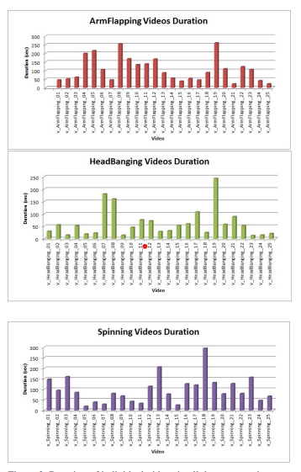
Dataset Analysis
Attributes | Description
URL | Reference website URL to the video
Persons | Number of persons in the video
Behaviors | Number of stimming behaviors in the video
Time | The behaviour start:end time instant in a video
Body Part | Hand, Head, Face, Eye, Full
Category | Stimming behaviour category
Intensity | Behaviour Intensity - Low, Medium and High
Modality | Dominant behaviour modality like audio, video - for future use

Slide 14
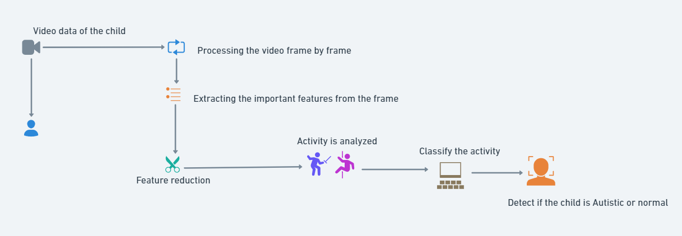
Framework of the Project

Slide 15
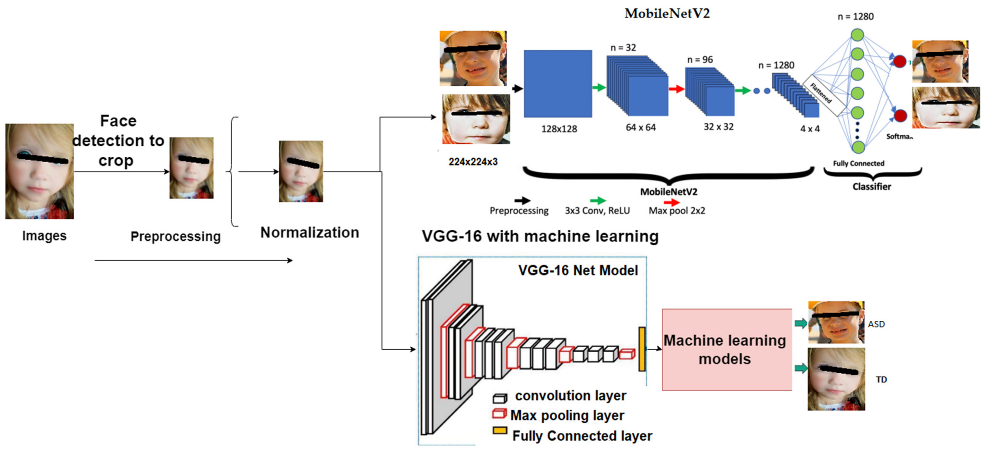
Block Diagram

Slide 16
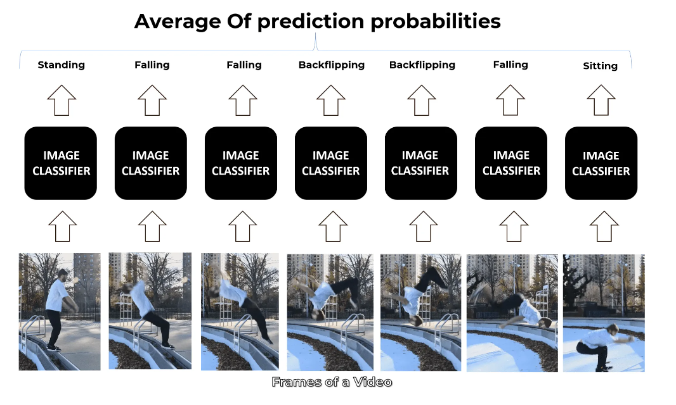
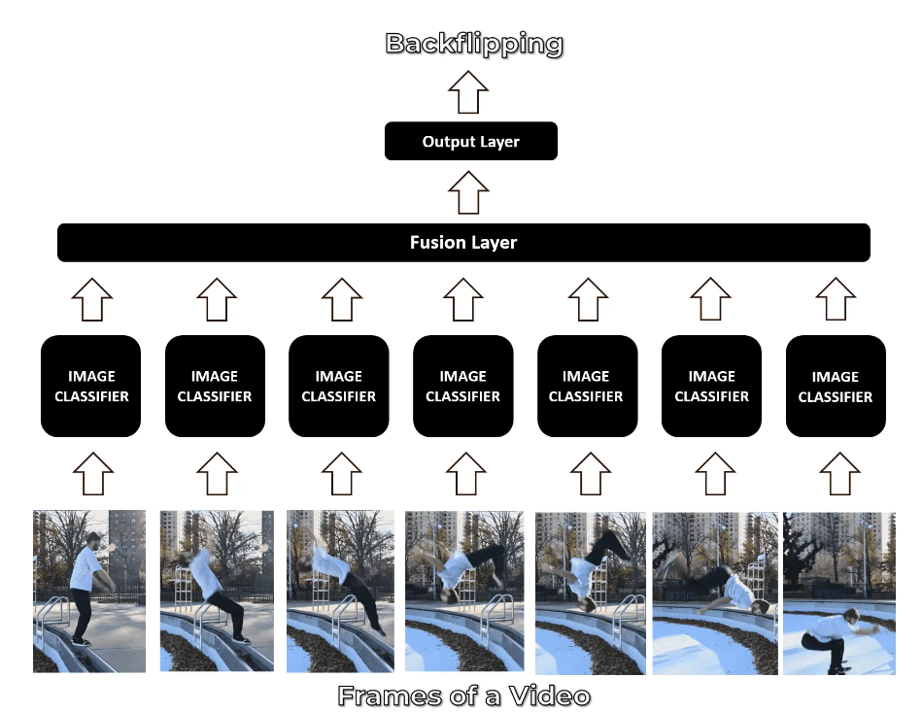
Block Diagram

Slide 17
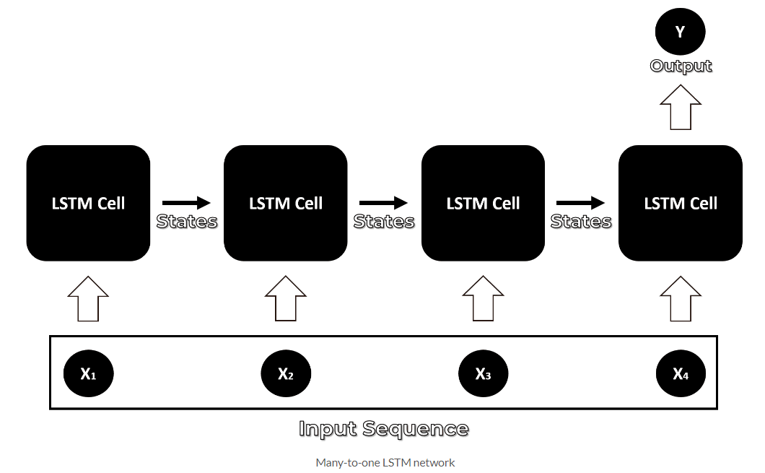
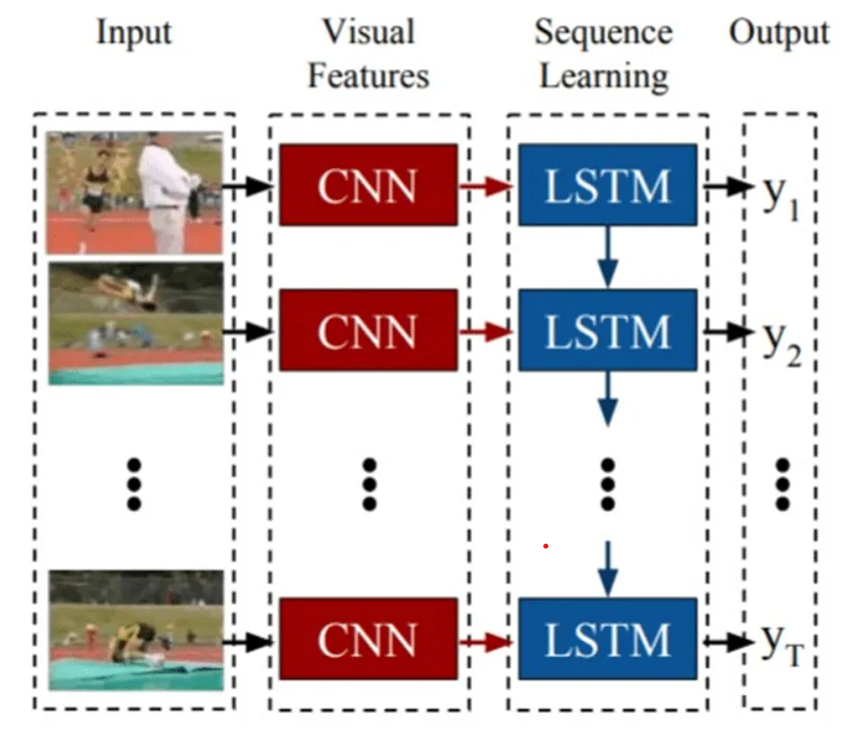
Block Diagram

Slide 18
Challenges
We have collected a dataset of 75 videos and are aiming to do a 3-class classification model (arm flapping, head banging and spinning). Lack of more behavioral based videos as datasets is the current challenge being faced.
ASD diagnosis continues to be a complicated challenge. The significant parameters include expert knowledge and particular diagnostic tools based on decoding child behavior, parent interviews, long-term follow ups and inspection of symptoms, and manual analysis. These assessments are time-consuming and clinically require arduous processes. Human assessments are subjective and inconsistent.
Stereotypical self-stimulatory behavior which is considered as a significant clue of this disorder does not comprise any rule or constraint that are common in regular action datasets.
Most of the available public datasets for diagnosis of ASD centered on emotional involvement, facial expression and eye movement
To study subjects’ behavior from videos in an uncontrolled natural environment we have collected a novel dataset from children attending the clinical center and willing to take part in our studies.

Slide 19
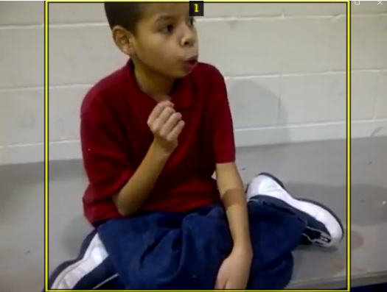
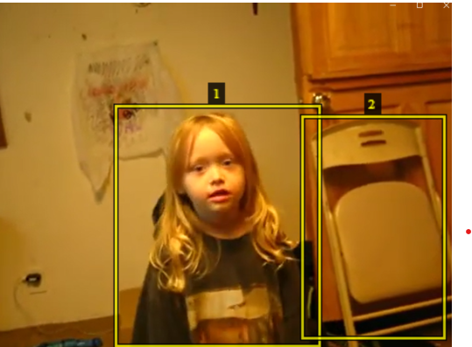
Annotation Tool – VGG Image Annotator (VIA)
https://www.robots.ox.ac.uk/~vgg/software/via/via_demo.html
VGG Image Annotator is a simple and standalone manual annotation software for image, audio and video. VIA is an open source project based solely on HTML, Javascript and CSS. VIA is developed at the Visual Geometry Group (VGG) and released under the BSD-2 clause license which allows it to be useful for both academic projects and commercial applications.

Slide 20
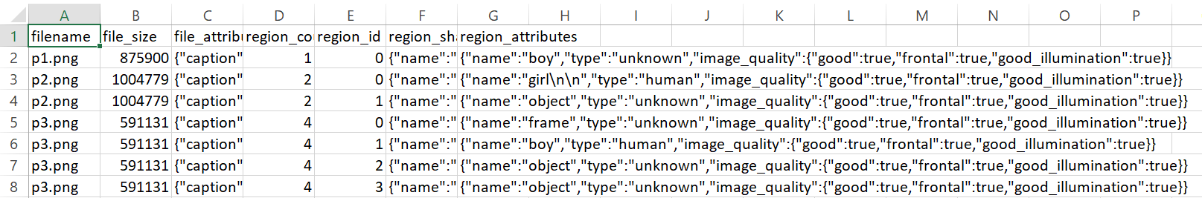
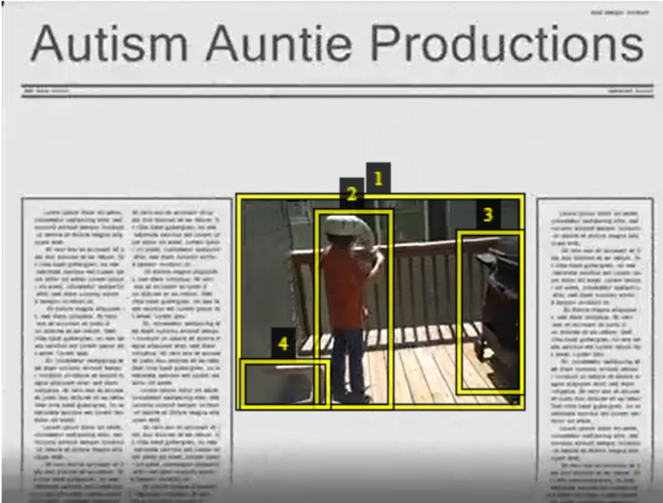
Annotation Tool

Slide 21
Literature Survey – Paper 1
https://inria.hal.science/hal-03447060v1/file/Abid_VISAPP_2022.pdf
Methodology:
Describe model architecture - based on 3D CNNs that processes RGB and optical flow data to classify and evaluate the behavior of children with Autism Spectrum Disorder (ASD)
Explain components: The use of 3D CNNs for action recognition demonstrates the potential of machine learning to analyze complex behaviors in children.
Outline the experimental setup, including data preprocessing, model training and testing: The experimental setup involves preprocessing RGB videos using YOLOv5 and DeepSORT for ROI extraction, followed by model training with a 3D CNN and testing through a multi-modality fusion network.
Software, hardware, resources used in the project - The project utilized a multi-GPU setup for training deep learning models, Python with PyTorch for implementation, and video data captured with an HD camera.
Describe datasets for training and testing - The training and testing datasets include the Activis dataset, consisting of 388 videos of children during assessments for Autism Spectrum Disorder, and the publicly available SSBD dataset with videos of self-stimulatory behaviors.
Summary of Findings: Results of different methods on the collected dataset. Results are stated on augmented data for all networks. A late fusion of two-stream I3D (RGB and optical flow) resulted in higher accuracy (in bold). All the methods use a 5-fold-cross-validation technique.
Dataset Accuracy: RGB only (78.8%), Flow only (84.97), Fusing during test (82.1), Early fusion (83.3%), Late fusion (85.6)

Slide 22
Literature Survey – Paper 2
https://rolandgoecke.net/wp-content/uploads/2009/05/rajagopalan_dhall_goecke_iccv2013_dscsi_self-stimulatorybehavioursinthewildforautismdiagnosis.pdf
Methodology:
Describe model architecture - Bag Of Words (BOW) framework for training a 3-class classifier
Explain components: Interest point detection and feature extraction, specifically employing Space Time Interest Points (STIP) with Harris3D detectors
Outline the experimental setup, including data preprocessing, model training and testing - involves preprocessing the video data by extracting Space Time Interest Points (STIP) and generating feature descriptors, followed by training a 3-class classifier using a Bag Of Words (BOW) framework on the processed features, and testing the model using a "Leave-One-Group-Out" validation approach to evaluate its performance on unseen data
Software, hardware, resources used in the project - VLFeat library for image classification and feature extraction, along with standard computational resources for processing the video dataset
Describe datasets for training and testing - The dataset consists of 75 videos categorized into three stimming behaviours: arm flapping, head banging, and spinning, with 25 videos per category
Summary of Findings: The baseline experiments on the dataset yielded a low classification accuracy of 47.1%, indicating the need for improved models to better analyze self-stimulatory behaviours in children
Dataset Accuracy : Accuracy of 47.1%

Slide 23
Literature Survey – Paper 3
https://www.mdpi.com/2076-3417/13/8/4855
Methodology:
Model architecture : CNN
Outline the experimental setup, including data preprocessing, model training and testing : CNNs consist of layers that perform convolution operations, pooling, and fully connected layers. Dense layers are fully connected layers that follow the convolutional and pooling layers in a CNN. Dense layers would help in classifying whether a child has ASD based on the features derived from their facial landmarks
Describe datasets for training and testing : Dataset used in the study consists of 2940 images of children, both with and without autism. The images were preprocessed to ensure uniformity in size (224 x 224 pixels) and format (RGB color model) before being fed into the model for training and testing . The dataset was split into 80% for training and 20% for testing.
Software, hardware, resources used in the project: The project utilized Jupyter Notebook for coding and model development, with Python as the programming language. While the contexts do not specify the hardware used, deep learning tasks typically require powerful GPUs for efficient training of models, especially with large datasets.
Dataset Accuracy :The MobileNetV2 model achieved an impressive accuracy of 92% on the test set, indicating its effectiveness in identifying children with autism based on facial landmark detection.

Slide 24
Machine Learning Model
Algorithm Name | Student contributed
CNN + LSTM | Abineha
3D CNN | Naveen
Bag of visual words model | Vaishnavi
Provide diagram, procedure, results with/ without hyperparameter tuning.
Sample of result can be seen in next slide.
Comparison table

Slide 25
CNN+LSTM
Provide diagram, procedure, results with/ without hyperparameter tuning.
Sample of result can be seen in next slide.
1.intro (cv n ur perspectv- what is cv )
2.dl in cv why +what+ how it solves our problem (analytical, reserch qs )
3.3 papers wrt model per person (cv research for partcular arch, what distance n geometric related prob cv solves )
4.wrt features describe your model + what special abt arch + methodology of arch + why u chose wrt to prob
5.cv related approach for ur appl. (if exist cite+ their conclusion)
6.diagram+steps of algorithm+parameters+values
7.why arch wrt dataset
8.proposed + modification hyper para tuning
9.metrics + why+ why not others+ common across 3 of us to compare formula of the metrics

Slide 26
2. 3D CNN
Provide diagram, procedure, results with/ without hyperparameter tuning.
Sample of result can be seen in next slide.

Slide 27
3. BOW
Provide diagram, procedure, results with/ without hyperparameter tuning.
Sample of result can be seen in next slide.

Slide 28
1.intro
2.what is cv dl in cv why +what+ how it solves our problem
3.3 papers wrt model per person
4.wrt features describe your model + what special abt arch
5.cv related approach for ur appl. (if exist cite+ their conclusion) 6.diagram+steps of algorithm+parameters+values
7.why arch wrt dataset
8.proposed + modification hyper para tuning
9.metrics + why+ why not others+ common across 3 of us to compare formula of the metrics

Slide 29
References
Abid Ali, Farhood F Negin, Francois F Bremond, Susanne Thümmler. Video-based Behavior Understanding of Children for Objective Diagnosis of Autism. VISAPP 2022 - 17th International Conference on Computer Vision Theory and Applications, Feb 2022, Online, France. ⟨hal-03447060⟩
S. S. Rajagopalan, A. Dhall and R. Goecke, "Self-Stimulatory behaviors in the Wild for Autism Diagnosis," 2013 IEEE International Conference on Computer Vision Workshops, Sydney, NSW, Australia, 2013, pp. 755-761, doi: 10.1109/ICCVW.2013.103.

